Slide 1
nandini
Laddo baapu ki

Slide 2
Nandini : laddo baapu ki
Nandini, 21 saal ki ek chote se gaon ki manchali si ladki. Jiska jindagi ka ek hi maksad hai, jitna ho sake Khushi baato. Gam kiski jindagi mein nahi hota, par Nandini gum ko Khushi ki khilkariyon mein bhula deti hai. Choti si umar mein hi apni maa ko khone ke baad se hi, ke Pita KUNJ BIHARI (48) jo ki gaon ke hi ek Vidya hai, wahi Nandini ki maa, baap aur dost hai. Jadibutiyon se Nandini ka bhi khaas lagaw hai… Uska manna hai ki prakriti mein hi har bimari ka ilaj chupa hai. Wo jadibuti jiske liye ye gaon mashoor hai. Jis gaon mein aaj khushali hai, wo gaon ek dasak pehle jadibutiyon ke alawa apne afeem ke karobar ke liye bhi mashoor tha. Jo Karobar karta tha Tantrik BHIMA, Bhima se jyada pura gaon uski shagird SANTAVNA se kanpta tha. Santavna jise log Santo ke naam se jante the. Bhima ki achanak mrityu ke baad Santo ne hi ye karobar sambhala tha. Par Santo insabki soch se kahin aage thi, thodi hi waqt mein Santo ne gaon chod kar MOHALI seher mein apna karobar bana liya tha. Jahan log use Santavana ke naam se hi jante hai, uske paas naam paisa aur sohrat hai. Aur do bete bhi… Bada beta PAWAN (28), chota beta VAYU (25).

Slide 3
Pawan Santo ke saath mil kar saare bure kaam karta hai. Drug afeem ki taskari, wo raaj jo in dono ke alawa kisi ko nahi pata. Pawan ki ek biwi bhi hai – JANVI (23). Jo Pawan ke hi dost ki girlfriend hua karti thi, par Janvi ki khubsurti par nazar padte hi Pawan ne apne hi dost ka murder kar Jhanvi se shaadi kar li. Tabse Janvi is ghar mein bahu ban kar rehti to hai… Par mann hi mann wo Santo ke is Parivar ko barbaad karne ka mauka talaash rahi hai. Santo ka chota beta Vayu, sirf apne aur is karobar ko badhane ke baare mein sochta rehta hai, uske liye insaan se jyada paisa aur rubab ki keemat hai. Wo apne Parivar ke alawa har insaan ko chota maanta hai. Par apni maa ki pooja karta hai, Santo ki kahi koi baat nahi talta. Isliye Santo ke kehne par Vayu uske saath gaon mein aya hai. Santo apne gaon har paanch saal mein ati hai, chunav jeetne. Aur isi wajah se is gaon ka kuch jyada Vikas nahi ho paya. Aur yahi baat Nandini ko chubti hai, is baar Nandini ne mann bana rakha hai ki wo Santo ke gaon mein aate hi is baat par apni awaaz uthaegi. Is gaon mein naa to sahi dhang se aspatal hai, na hi bacchon ki siksha ke liye accha sa vidhyalaye

Slide 4
Santo mein gaon mein aate hi, Nandini ki mulakat Vayu se hoti hai. Nandini notice karti hai ki kis taraf Vayu buri tarah se gaon walon ko majdoor ki tarah bartaw kar raha hai. Nandini ko ye dekh bohot gussa ata hai, aur wo Vayu se behes karti hai ki hum bhi insaan hai, aur wo force karti hai Vayu se maafi mangne ke liye, kaafi logon ko dekhte hue Vayu bina kuch kahe wahan se chala jata hai. Agle din jab Santo panchayat ke saamne chunav prachar karne jati hai to Nandini bina kisi jhijhak ke Santo se sawaal jawab karne lagti hai, apni maa ki beijjati hota dekh Vayu gusse mein aa jata hai, aur Nandini ko sabak sikhane ka mann bana leta hai. Vayu muh pe kapda bandh kar Nandini ko sunsaan sadak par daraane ka plan banata hai, par Nandini khud ko bacha kar ghar pohonchti hai. Par Nandini Vayu ke hath ka kada pehchan leti hai. Santo ko Vayu ki is harkat par bohot gussa ata hai, kyunki wo janti hai ki agar ye baat bahar nikal gayi to wo is baar ka chunav haar jaegi. Santo ko samajh mein ata hai ki Gaon walon ko Nandini se behad lagaw hai, aur wo uski baat sunte hai. Isliye Santo Vayu ko bina bataye uska Rishta lekar Vaidya ji ke paas jate hai. Vaidya ji apni beti ki Khushi ke liye turant hi is rishte ke liye maan jate hai. Par jab ye baat Vayu ko pata chalti hai to wo behad naraaz ho jata hai, par apni maa ki baat taal bhi nahi pata. Nandini janti hai Vayu mein manners nahi hai, par wo sochti hai ki apne guno se wo Vayu ke andar badlav le aegi.

Slide 5
Vayu aur Nandini ki shaadi karwane ke peeche Santo ka kuch alag hi maksad hai. Santo wo jadibuti dhund rahi hai, jiski tapasya se wo apne Tantrik guru Bhima ki shaktiyon ko punah jeevit kar sakti hai. Aur Nandini mein use umeed dikhti hai, kyunki Nandini ko un jadibutiyon ka accha gyaan hai. Shaadi ke baad Nandini Vayu ke ghar pohonchti hai, par shaadi ki raat ko hi Vayu Nandini ko alag kamre mein sone ko kehta hai. Vayu hamesha Nandini se nafrat karta hai aur apni biwi nahi manta. Vayu ke mann mein bas ek hi baat chal rahi hai ki Santo ke chunav jeet te hi wo Nandini ko divorce de dega. Idhar Pawan ki biwi Janvi bhi Nandini se nafrat karti hai, kyunki wo is ghar ke har ek sadasya ko pareshan karna chahti hai. Nandini ko nuksaan pohchane aur Santo ke Parivar ko tabah karne ke maksad se Janvi Nandini ke pati Vayu ke khane mein zeher mila deti hai. Jisse Vayu jindagi aur maut ki jang mein phas jata hai, doctors jawab dete-dete hai, par Nandini haar nahi manti, aur apne pati ko bachane ke liye wo gaon se durlabh jadibuti dhund kar lati hai. Santo un jadibuti ko dekh kar samajh jati hai ki isi se Tantrik bhim ki shaktiyan punah is duniya mein layi ja sakti hai. Kuch Jadibuti chura kar Santo tapasya mein lag jati hai… Shaktiyan aane hi wali hoti hai ki anjaane mein wo Shaktiyan Vayu ke andar chali jaati hai. Aur ek ajeeb sa Nishan uski hatheli mein aa jata hai.

Slide 6
Nandini ye dekh kar ghabra jati hai, aur kafi pata karne ke baad pata chalta hai ki ye kaali shaktiyan hai, agar ye kaali shaktiyan Vayu ke jism mein 90 dino tak rahengi to uski maut nishchit hai. Wahin Santo janti hai ki 90 dino baad agar wo apne hi bete Vayu ka balidaan degi to ye saari shaktiyan uski ho sakti hai. Kya Nandini jaise ek masoom biwi apni saas ke khilaf jakar apne pati ki jaan bacha paegi. Kya wo is Parivar ka dil jeet paegi? Kya wo Santo ke andar ke shaitaan ko mita paegi?
In prashno ka jawab janne ke liye dekhiye… Nandini– LADDO BAAPU KI……..

Slide 7
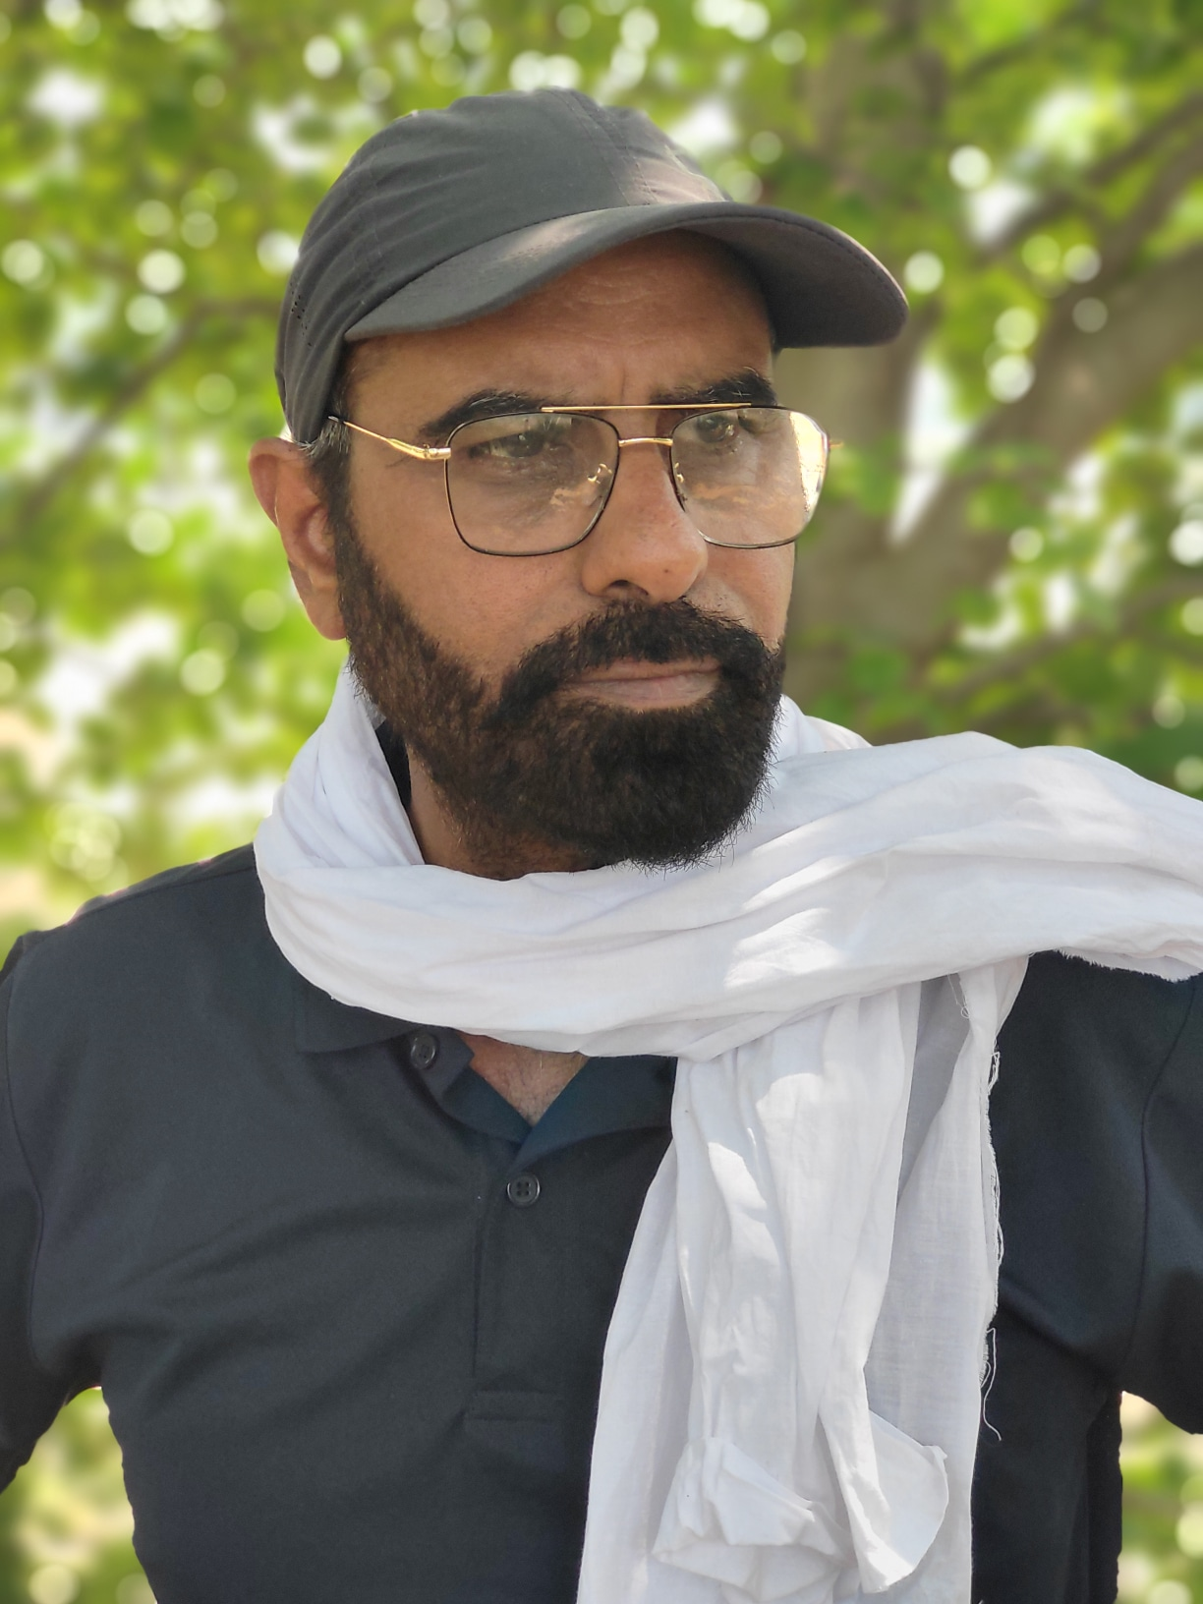
Directed by: mr.pretty

Slide 8
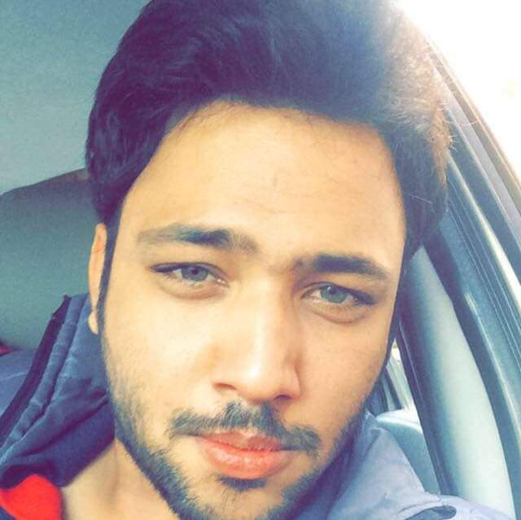
WRITTEN BY: MOHAMMAD ZEESHAN

Slide 9
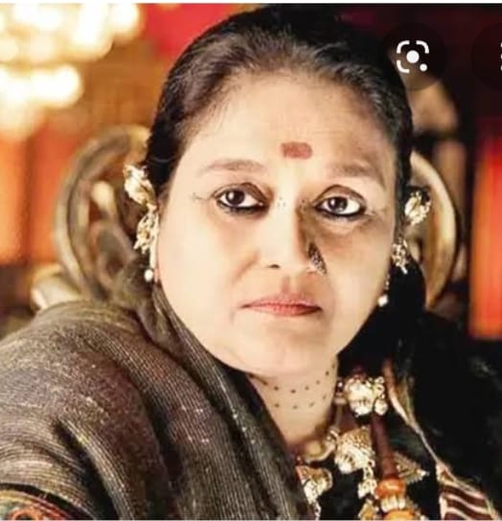
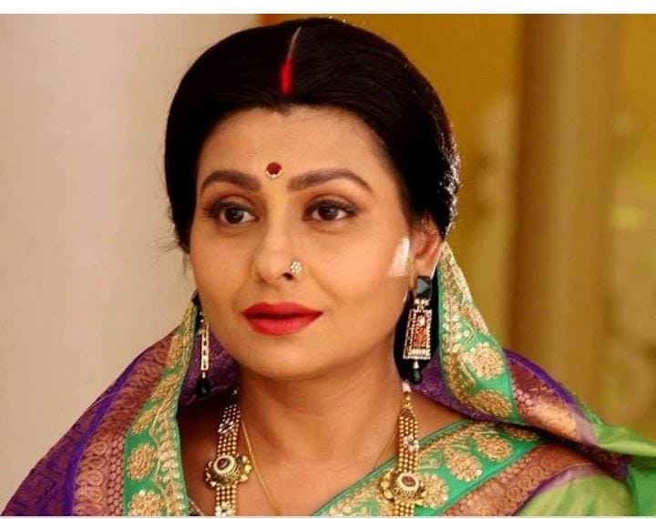
SANTAVNA
OR
SUPRIYA PATHAK
JAYA BHATTACHARYA

Slide 10
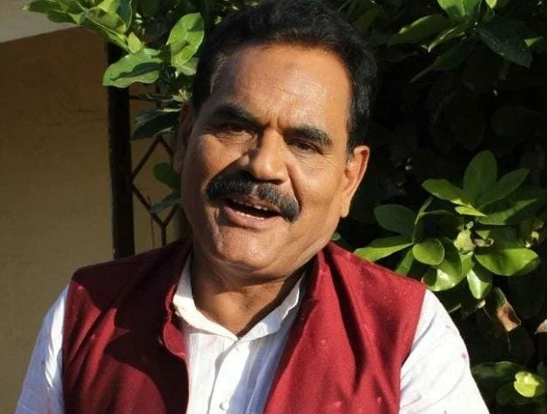
KUNJ BIHAARI : (NANDINI FATHER)
MUSHTAQ KHAN

Slide 11
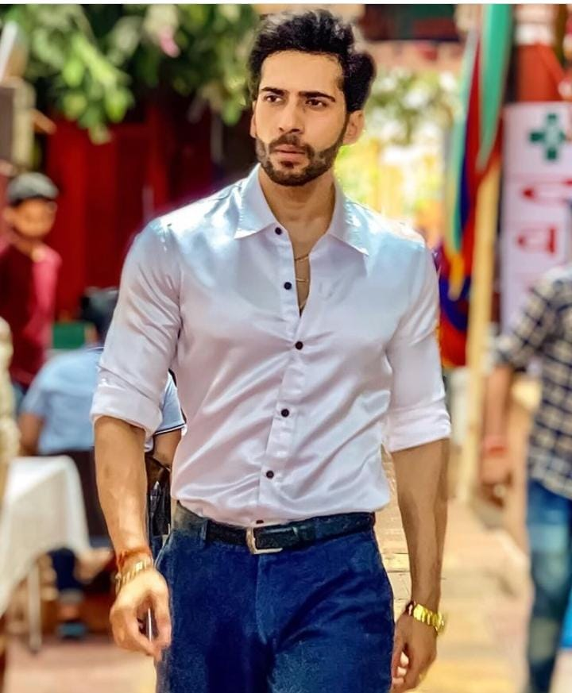
VAIBBHAV SINGH AS VAYU

Slide 12
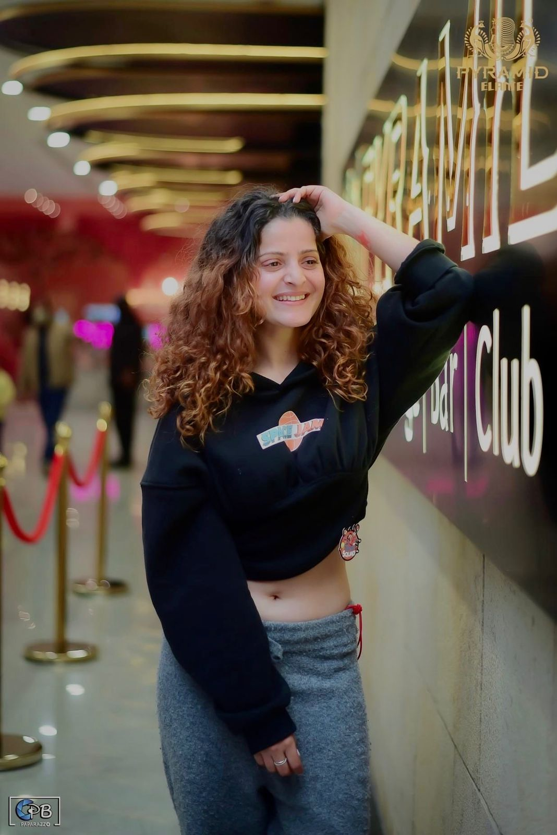
ONIKA AS NANDINI

Slide 13
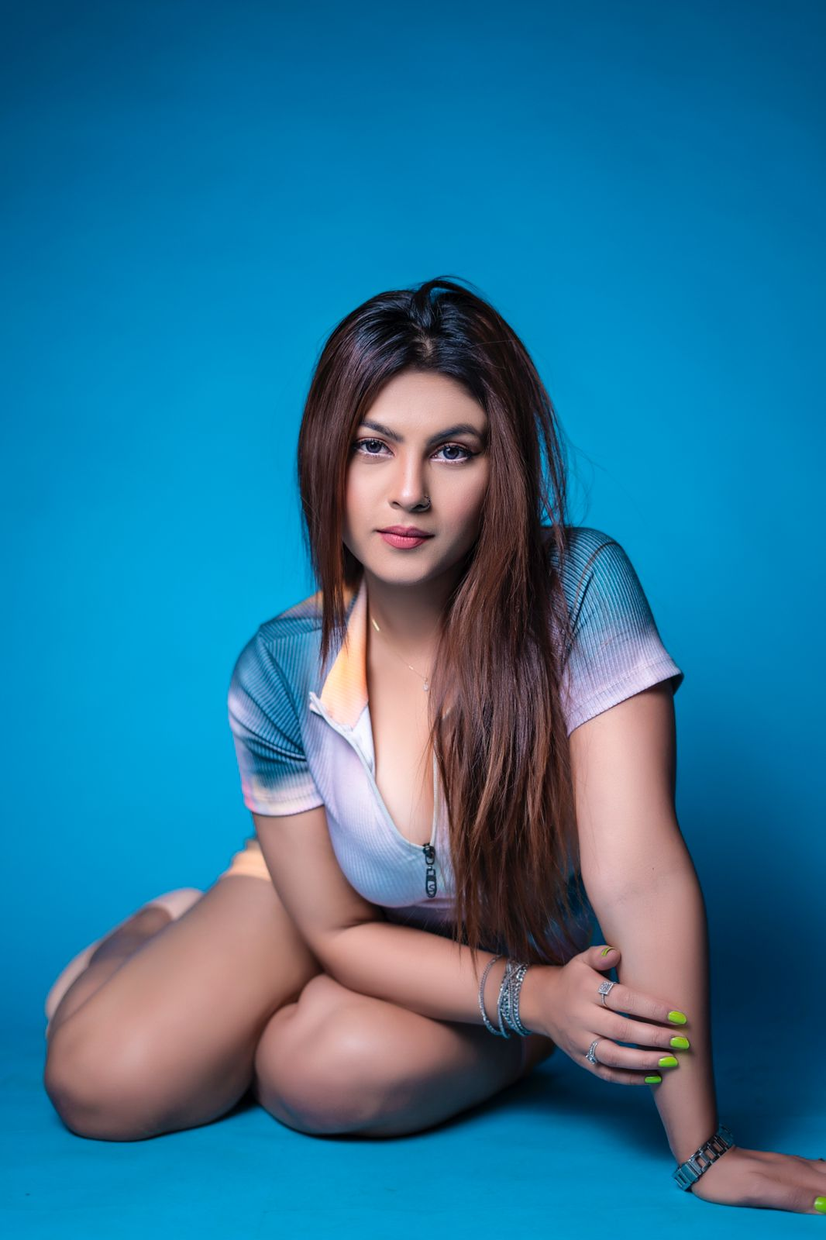
PARUL AS JANVI

Slide 14
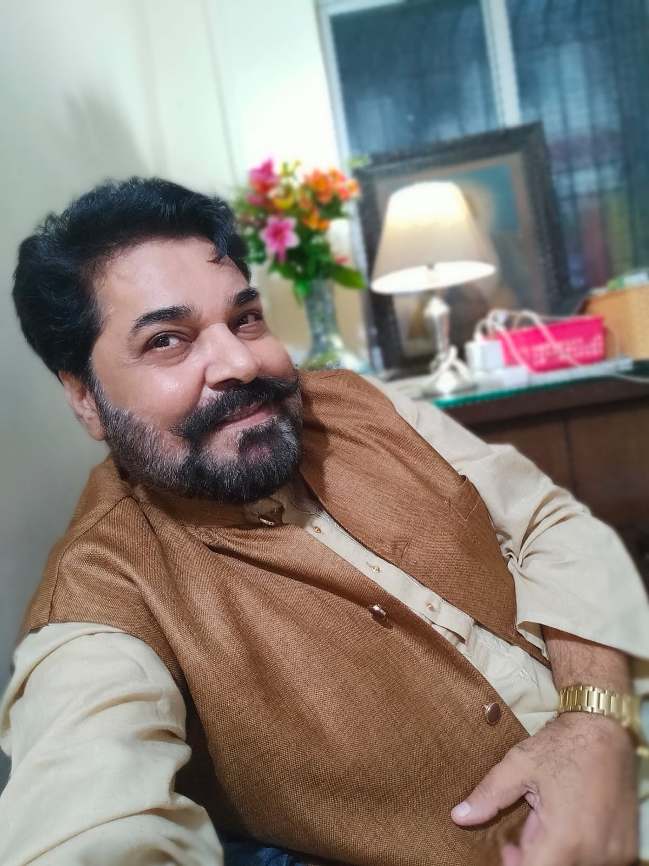
HARJEET WALIA AS BHIMA TANTRIK

Slide 15
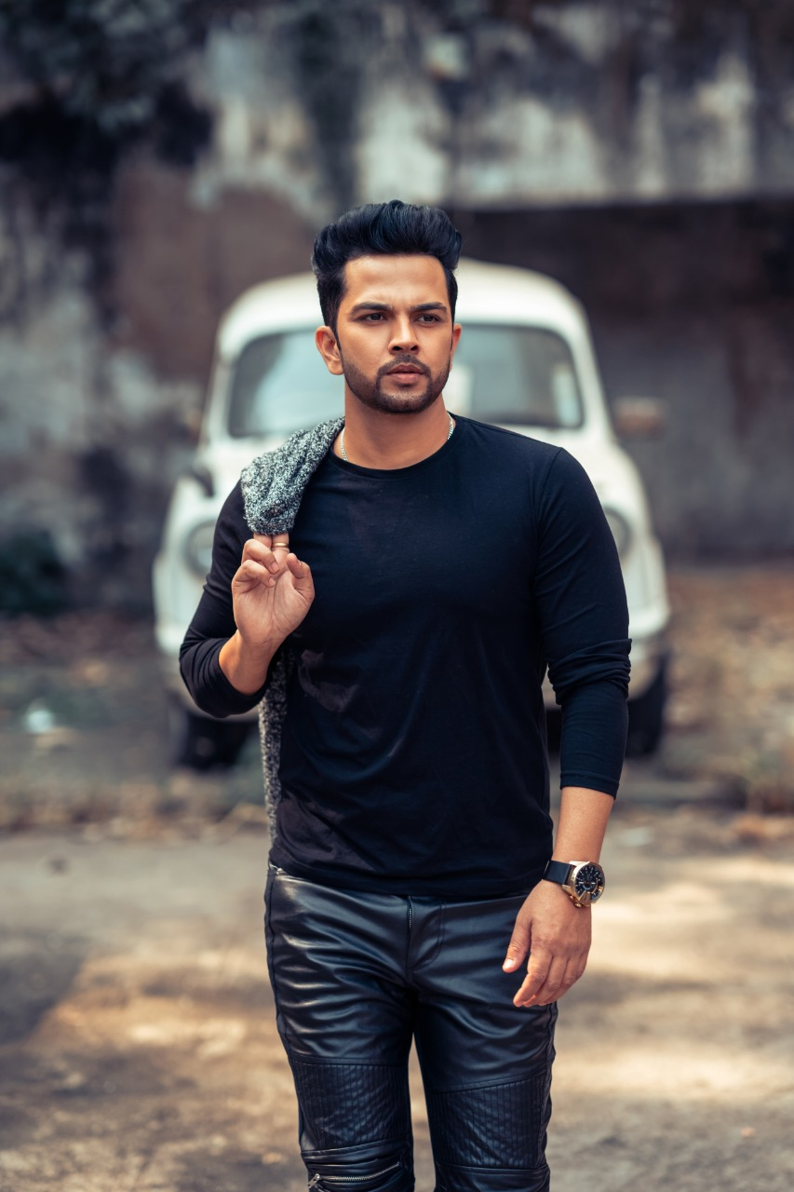
VINIT BHARDWAJ AS PAWAN

Slide 16
THANK YOU

